Slide 1

Learning Objective
I will be able to determine equations of a straight line
Enter quietly, please be ready with the following on your desk:
Whiteboard
Whiteboard marker
Exercise Book
Pencil, pen, ruler and red pen
Diary
Calculator (Scientific and ClassPad)
Device – charged or borrowed from Library before maths

Slide 2
Learning Objective
CFU
What will we learn today?
I will be able to determine equations of a straight line
CFU
How will you know that you are successful?
Success Criteria
At the end of the lesson, I will be able to:
recall how to determine the gradient and intercept of a linear relationship;
be able to identify a linear relationships from a table of values;
be able to determine the equation of a linear relationships using various methods;
know the different forms of linear relationships; and
be able to verify if a point lies on a given line..

Slide 3
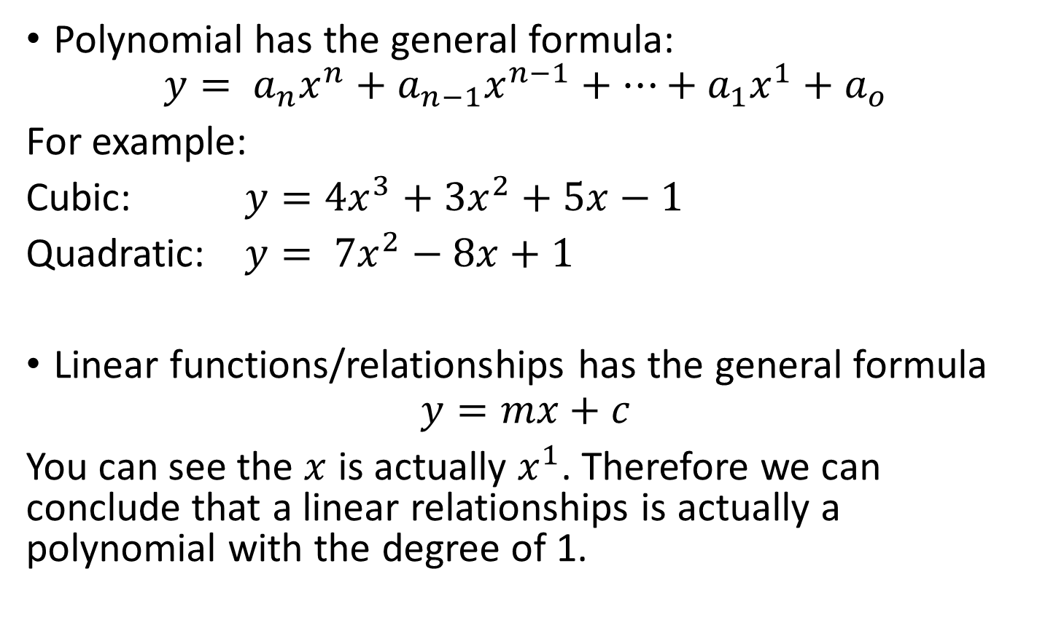
Linear functions/linear relationships
Concept Development
Polynomial has the general formula:
$$y= a_{n}x^{n}+a_{n−1}x^{n−1}+…+a_{1}x^{1}{+ a}_{o}$$
For example:
Cubic: $y={4x}^{3}+{3x}^{2}+5x−1$
Quadratic: $y= {7x}^{2}−8x+1$
Linear functions/relationships has the general formula
$$y=mx+c$$
You can see the $x$ is actually $x^{1}$. Therefore we can conclude that a linear relationships is actually a polynomial with the degree of 1.
Degree of the polynomial

Slide 4
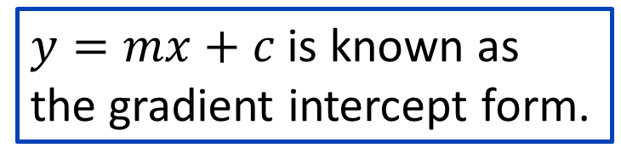
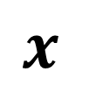
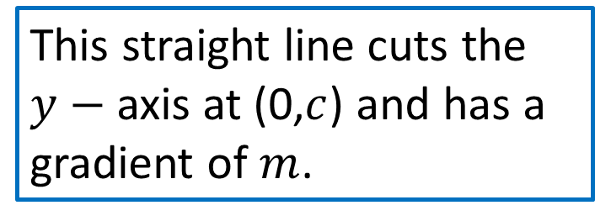
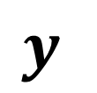
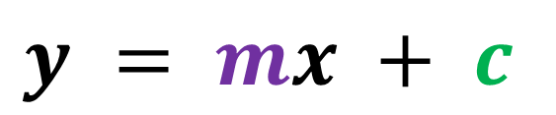
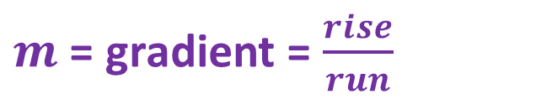
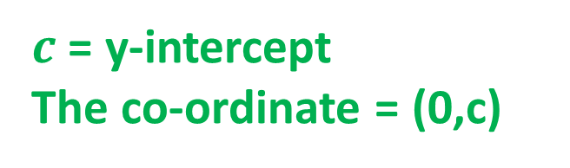
Activating prior knowledge
$$y$$
$$y = mx + c$$
$c$ = y-intercept
The co-ordinate = (0,c)
$m$ = gradient = $\frac{rise}{run}$
$$x$$
This straight line cuts the $y−$ axis at (0,$c$) and has a gradient of $m$.
$y=mx+c$ is known as the gradient intercept form.

Slide 5
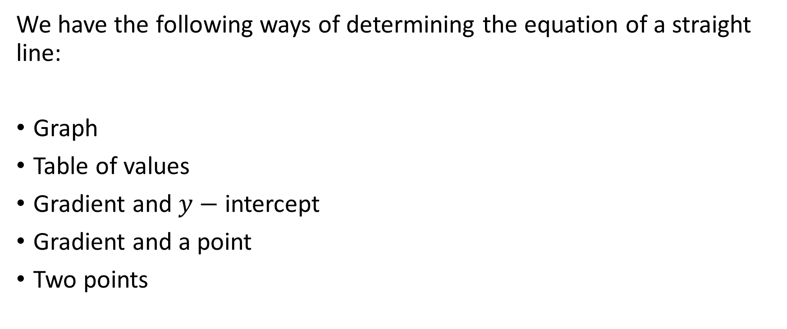
Ways of determining the equation of a straight line
Skill Development
We have the following ways of determining the equation of a straight line:
Graph
Table of values
Gradient and $y−$ intercept
Gradient and a point
Two points

Slide 6
Graphs

Slide 7
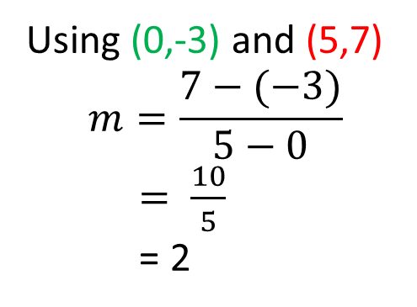
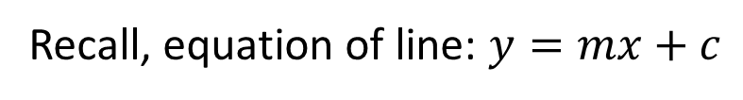
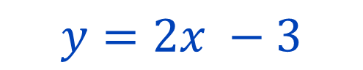
Guided Practice
Recall, equation of line: $y=mx+c$
Using (0,-3) and (5,7)
$$m=\frac{7−(−3)}{5−0}$$
$= \frac{10}{5}$
= 2
(5,7)
Step 1: Find y-intercept
Step 2: Work out gradient
Step 3: Re-write your equation
Intercept = (0,-3)
$$y=2x −3$$

Slide 8
Guided Practice
Recall, equation of line: $y=mx+c$
Step 1: Find y-intercept
Step 2: Work out gradient
Step 3: Re-write your equation

Slide 9
Table of values

Slide 10
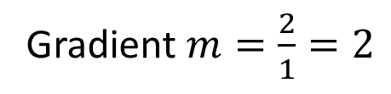
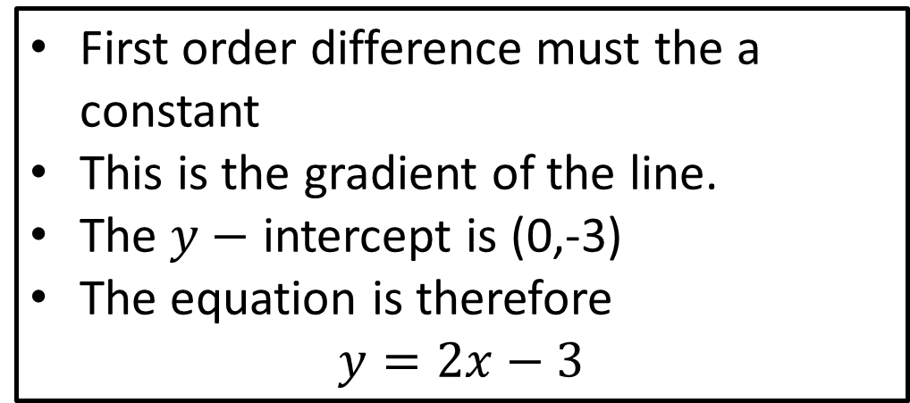
+1
+1
+1
+1
+1
+1
Gradient $m=\frac{2}{1}=2$
+2
+2
+2
+2
+2
+2
First order difference must the a constant
This is the gradient of the line.
The $y−$ intercept is (0,-3)
The equation is therefore
$$y=2x−3$$

Slide 11
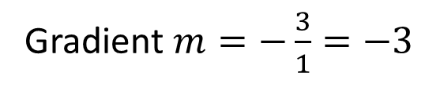
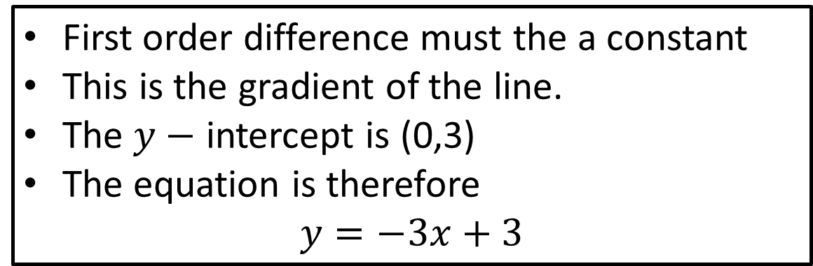
+1
+1
+1
+1
+1
+1
-3
-3
-3
-3
-3
-3
First order difference must the a constant
This is the gradient of the line.
The $y−$ intercept is (0,3)
The equation is therefore
$$y=−3x+3$$
Gradient $m=−\frac{3}{1}=−3$

Slide 12
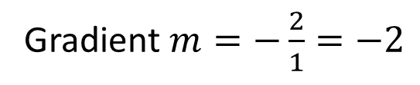
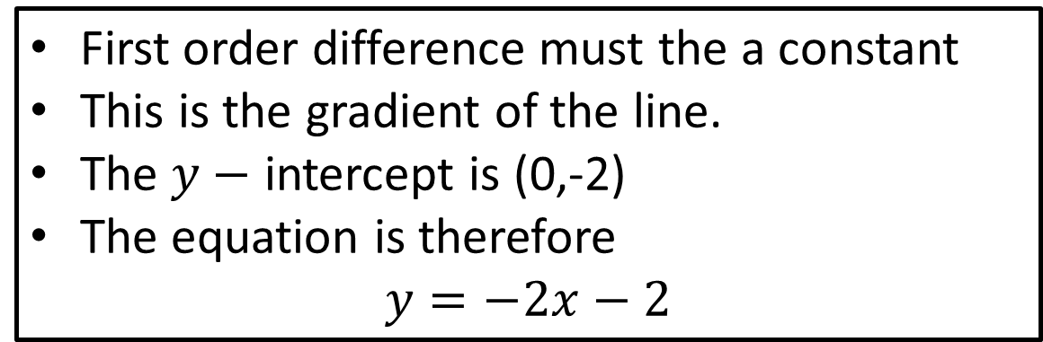
+1
+1
+1
-2
-2
-2
First order difference must the a constant
This is the gradient of the line.
The $y−$ intercept is (0,-2)
The equation is therefore
$$y=−2x−2$$
Gradient $m=−\frac{2}{1}=−2$

Slide 13
Gradient and intercept

Slide 14
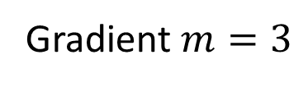
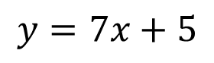
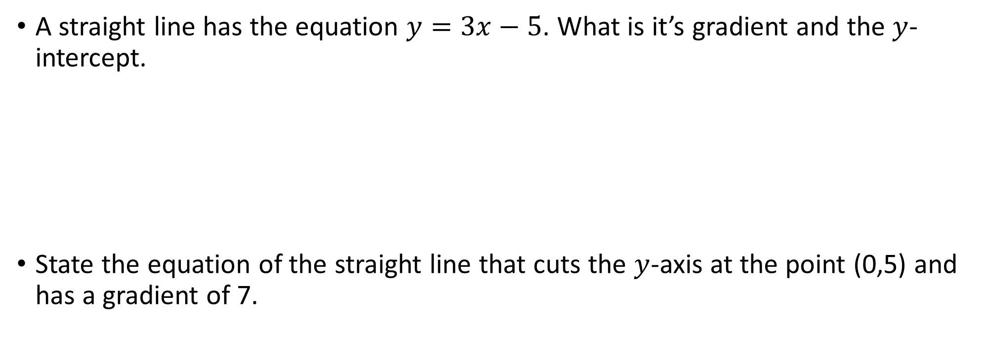
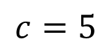
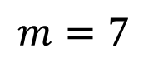
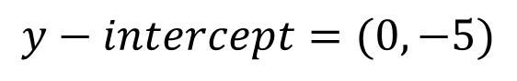
A straight line has the equation $y=3x−5$. What is it’s gradient and the $y$-intercept.
State the equation of the straight line that cuts the $y$-axis at the point (0,5) and has a gradient of 7.
Gradient $m=3$
$$y−intercept=(0,−5)$$
$$m=7$$
$$c=5$$
$$y=7x+5$$

Slide 15
Gradient and a point

Slide 16
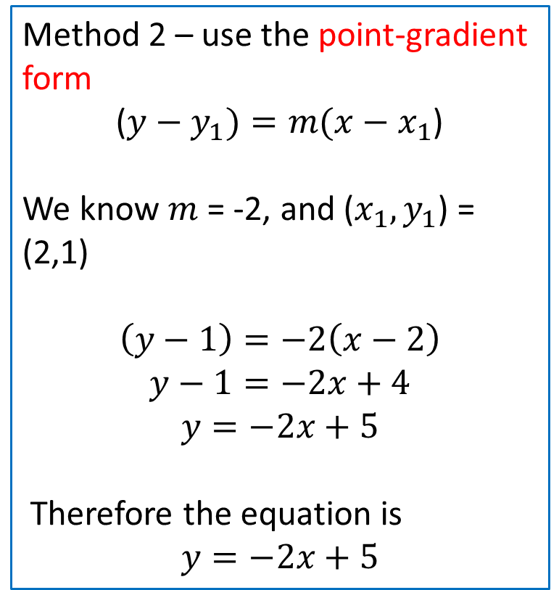
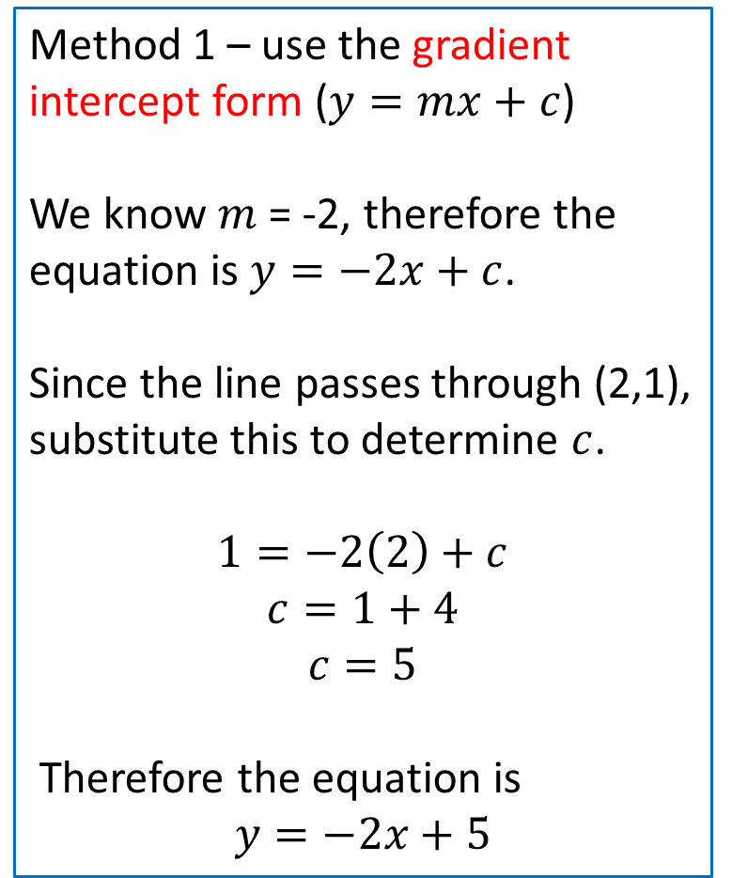
Find the equation of the straight line with the gradient of -2 and passes through the point (2, 1).
Method 1 – use the gradient intercept form ($y=mx+c$)
We know $m$ = -2, therefore the equation is $y=−2x+c$.
Since the line passes through (2,1), substitute this to determine $c$.
$$1=−2\left(2\right)+c$$
$$c=1+4$$
$$c=5$$
Therefore the equation is
$$y=−2x+5$$
Method 2 – use the point-gradient form
($y−y_{1})=m(x−x_{1}$)
We know $m$ = -2, and ($x_{1},y_{1}$) = (2,1)
$$\left(y−1\right)=−2\left(x−2\right)$$
$$y−1=−2x+4$$
$$y=−2x+5$$
Therefore the equation is
$$y=−2x+5$$

Slide 17
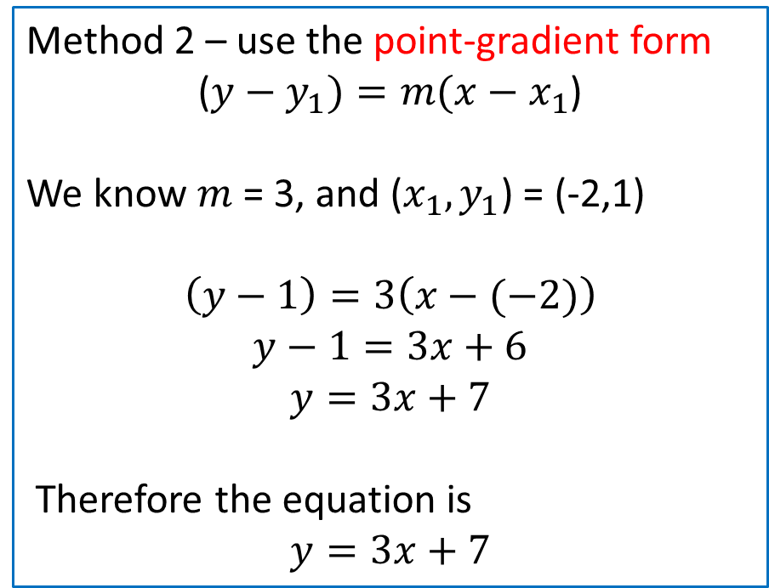
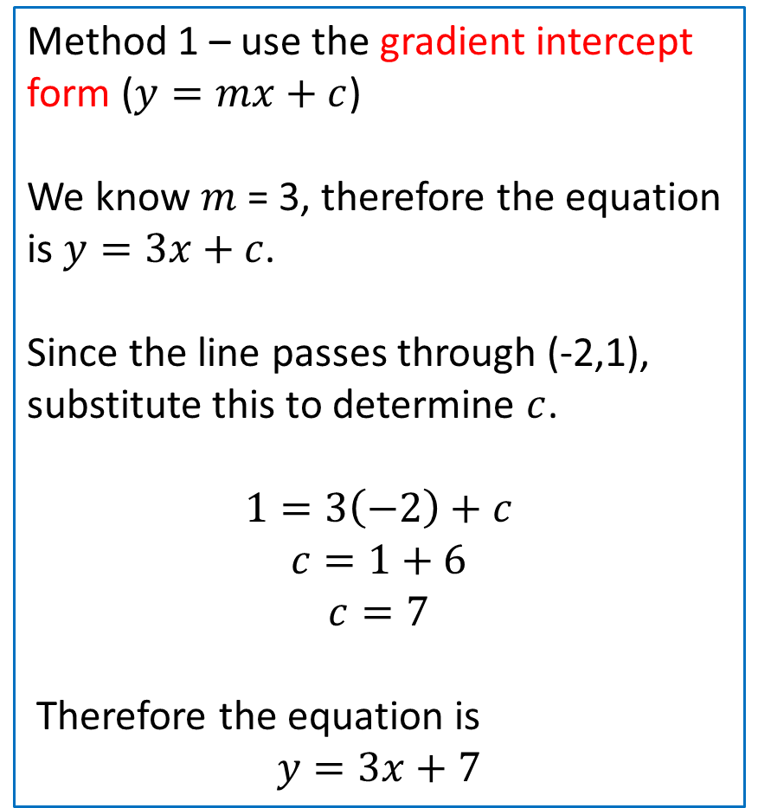
Find the equation of the line with the gradient of 3 and passes through the point (-2, 1).
Method 1 – use the gradient intercept form ($y=mx+c$)
We know $m$ = 3, therefore the equation is $y=3x+c$.
Since the line passes through (-2,1), substitute this to determine $c$.
$$1=3\left(−2\right)+c$$
$$c=1+6$$
$$c=7$$
Therefore the equation is
$$y=3x+7$$
Method 2 – use the point-gradient form
($y−y_{1})=m(x−x_{1}$)
We know $m$ = 3, and ($x_{1},y_{1}$) = (-2,1)
$$\left(y−1\right)=3\left(x−(−2)\right)$$
$$y−1=3x+6$$
$$y=3x+7$$
Therefore the equation is
$$y=3x+7$$

Slide 18
Two points

Slide 19
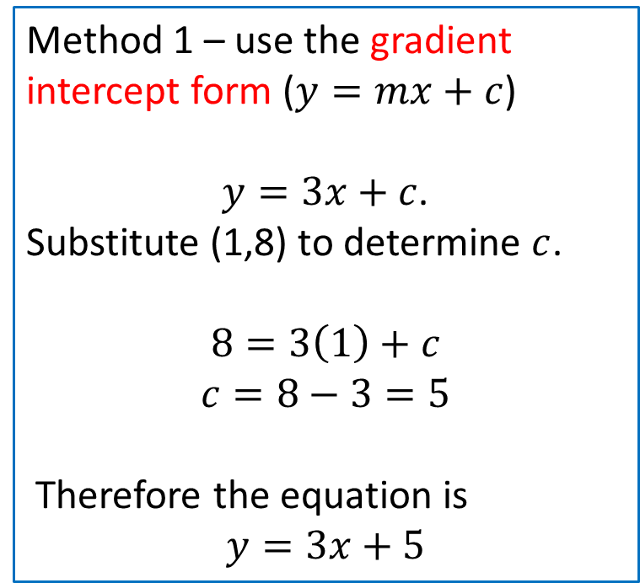
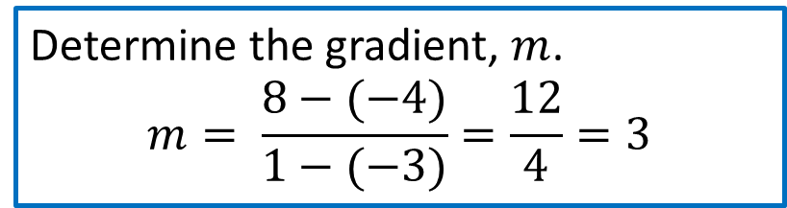
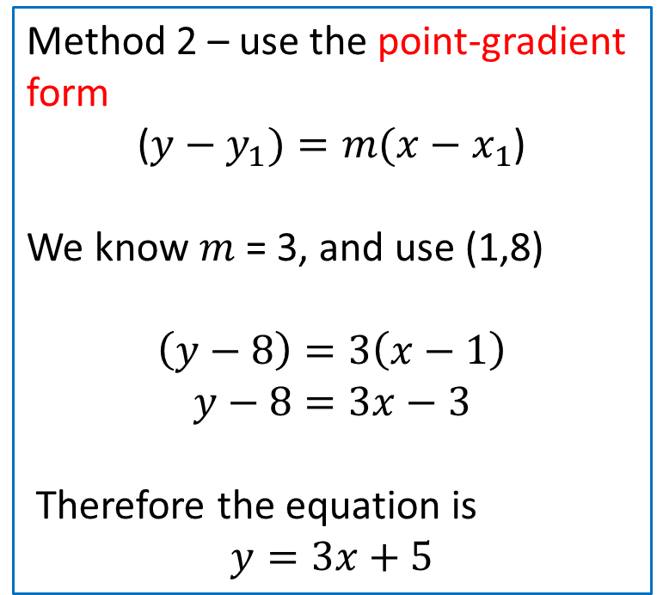
Find the equation of a straight line which passes through the points (-3,-4) and (1,8).
Determine the gradient, $m$.
$$m= \frac{8−(−4)}{1−(−3)}=\frac{12}{4}=3$$
Method 1 – use the gradient intercept form ($y=mx+c$)
$y=3x+c$.
Substitute (1,8) to determine $c$.
$$8=3\left(1\right)+c$$
$$c=8−3=5$$
Therefore the equation is
$$y=3x+5$$
Method 2 – use the point-gradient form
($y−y_{1})=m(x−x_{1}$)
We know $m$ = 3, and use (1,8)
$$\left(y−8\right)=3\left(x−1\right)$$
$$y−8=3x−3$$
Therefore the equation is
$$y=3x+5$$

Slide 20
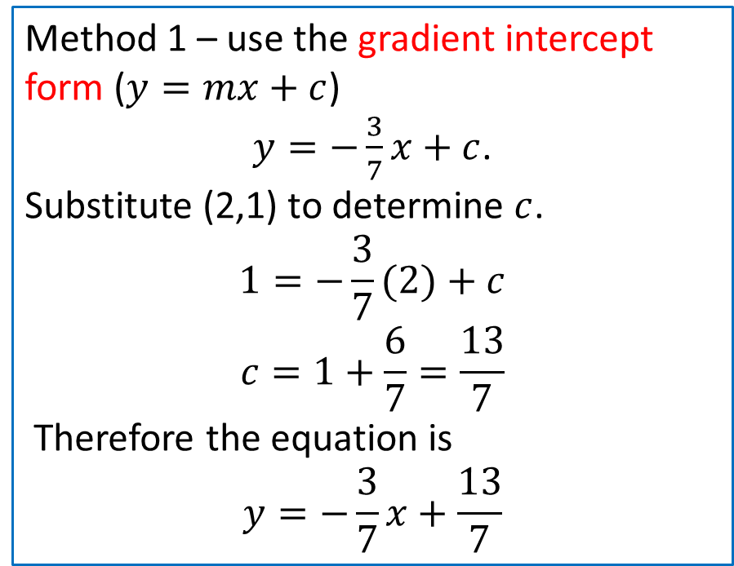
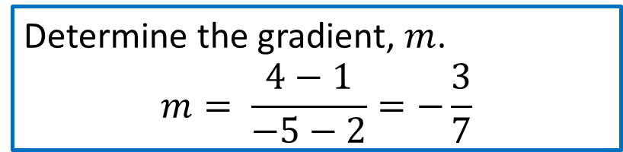

Find the equation of the which passes through the point (2, 1) and (-5, 4).
Determine the gradient, $m$.
$$m= \frac{4−1}{−5−2}=−\frac{3}{7}$$
Method 1 – use the gradient intercept form ($y=mx+c$)
$y=−\frac{3}{7}x+c$.
Substitute (2,1) to determine $c$.
$$1=−\frac{3}{7}(2)+c$$
$$c=1+\frac{6}{7}=\frac{13}{7}$$
Therefore the equation is
$$y=−\frac{3}{7}x+\frac{13}{7}$$
Method 2 – use the point-gradient form
($y−y_{1})=m(x−x_{1}$)
We know $m=−\frac{3}{7}$, and use (2,1)
$$\left(y−1\right)=−\frac{3}{7}\left(x−2\right)$$
$$y−1=−\frac{3}{7}x+\frac{6}{7}$$
Therefore the equation is
$$y=−\frac{3}{7}x+\frac{13}{7}$$

Slide 21
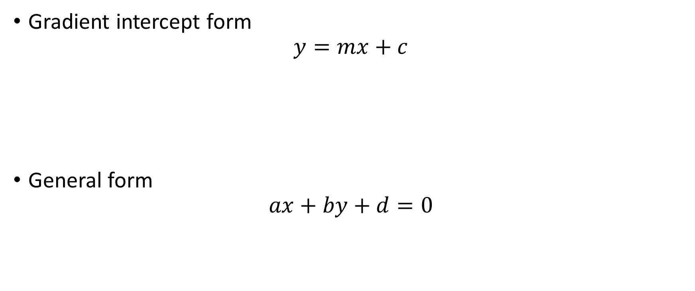
Different forms of linear equation
Gradient intercept form
$$y=mx+c$$
General form
$$ax+by+d=0$$

Slide 22








A straight line has equation $3x+5y=20$. Determine its gradient and the co-ordinate of the $y$-intercept.
$$3x+5y=20$$
Rearrange equation into $y=mx+c$ form
$$5y=20−3x$$
$$y=\frac{20−3x}{5}$$
$$y=−\frac{3}{5}x+4$$
Gradient, $m=−\frac{3}{5}$
Y-intercept, $=(0, 4)$

Slide 23







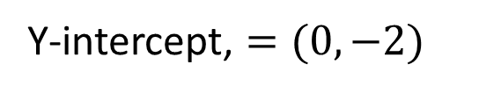
A straight line has equation $7x−2y=4$. Determine its gradient and the co-ordinate of the $y$-intercept.
$$7x−2y=4$$
Rearrange equation into $y=mx+c$ form
$$7x=2y+4$$
$$7x−4=2y$$
$$2y=7x−4$$
$$y=\frac{7}{2}x−2$$
Gradient, $m=\frac{7}{2}$
Y-intercept, $=(0, −2)$

Slide 24



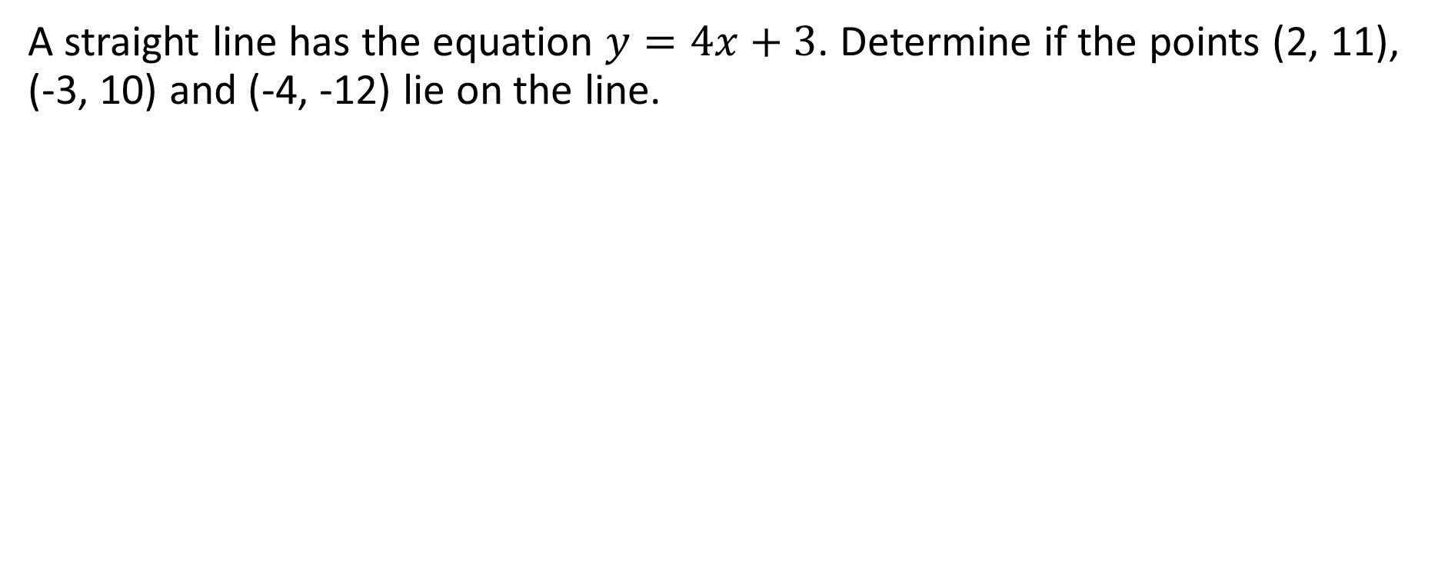
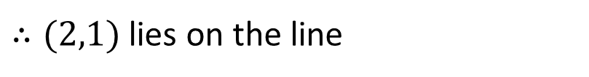




The co-ordinates of every point lying on a straight line will ’fit’ the equation of the line and every point not lying on the line will not fit the equation.
A straight line has the equation $y=4x+3$. Determine if the points (2, 11), (-3, 10) and (-4, -12) lie on the line.
$$(2,11)$$
$$(−3,10)$$
Subst $x=2$ into $y=4x+3$
Subst $x=−3$ into $y=4x+3$
$$y=4\left(2\right)+3=11$$
$$y=4\left(−3\right)+3=9$$
$∴(2,1)$ lies on the line
$∴(−3,10)$ does not lie on the line

Slide 25
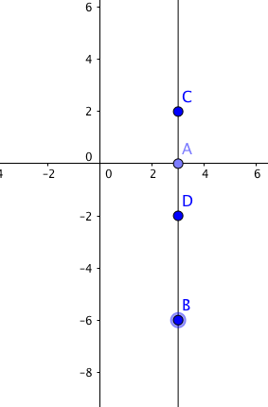
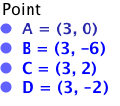
Vertical line
For a vertical line, all the co-ordinates have the same value of x but the value of y can be any value.
Therefore the vertical line through any point (a,b) will have the equation x = a.
x = 3

Slide 26
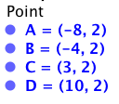
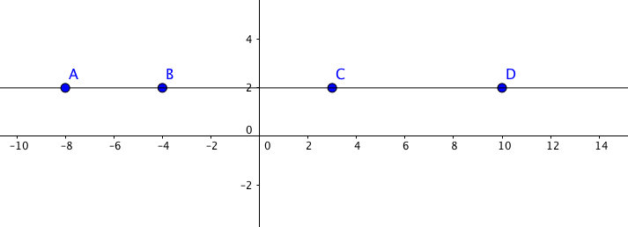
Horizontal line
For a horizontal line, all the co-ordinates have the same value of y but the value of x can be any value.
Therefore the horizontal line through any point (a,b) will have the equation y = b.
y = 2

Slide 27
Independent Practice
Complete Cambridge Ex 2C

